Slide 1
CLASS OF 2025: SENIOR YEAR INFORMATION
Little Miami High School
April 11, 2024

Slide 2

CONTACT INFORMATION
School Counselors:
  Ashley Brown (A-C)
  abrown@lmsdoh.org
  Brittani Murphy (D-H)
    bmurphy@lmsdoh.org
  Amanda Duffy (I-M)
  aduffy@lmsdoh.org
  Jared Flanagan (N-So)
jflanagan@lmsdoh.org
  Brandy Stith (Sp-Z)
  bstith@lmsdoh.org
  Graduation Information: Community Service:
  Jen Lyke Sharon Stein
  jlyke@lmsdoh.org sstein@lmsdoh.org

Slide 3
GRADUATION INFORMATION
20.5 credits in all necessary subject areas
  Please remember that senior year grades do matter. We will send a final transcript at the end of senior year.
Graduation Points and Seals earned
12 Hours of Community Service - by April 1st
Cap and Gown Meeting - Early October
A letter will be sent home in the fall detailing graduation information
Graduation Practice/Senior Picnic - Mandatory
Graduation – Sunday, May 18, 2025 @ 6:00 PM
  Wright State University - Nutter Center

Slide 4
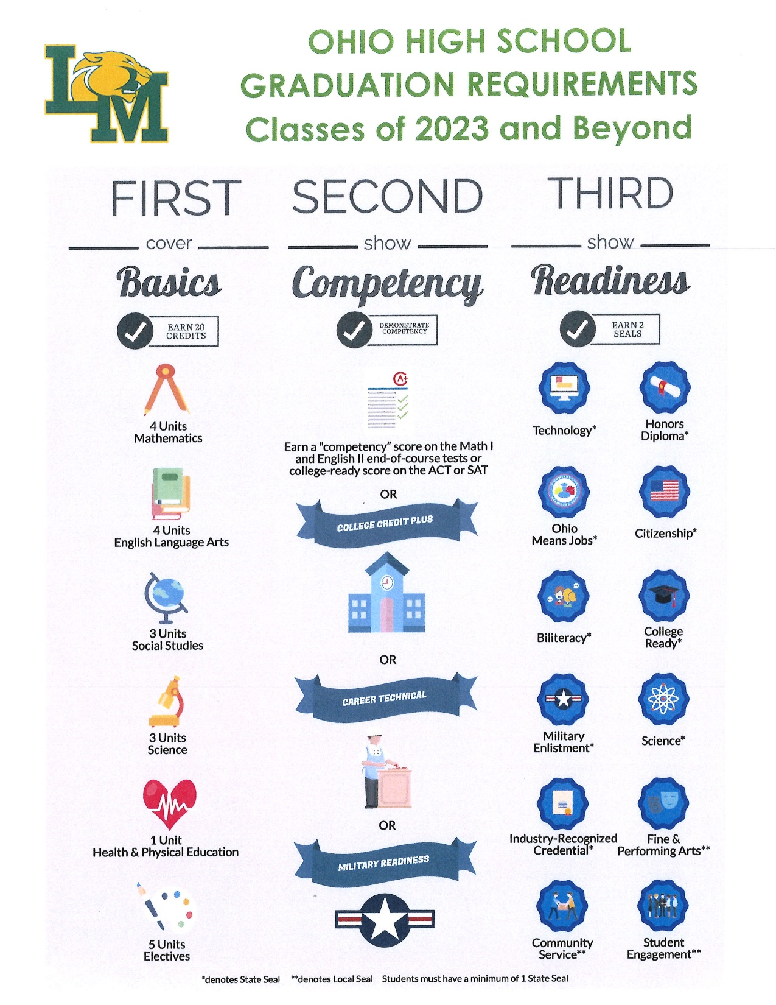

Slide 5
SENIOR YEAR TIMELINE

Slide 6
August/September
  Large Group Meeting with counselors
  Counselors visit with Senior English classes
  Individual senior meeting with your counselor
  Sign up for a Common Application account if needed (www.commonapp.org)
  Start your college applications
  Attend college representative/military meetings at LMHS and take the ASVAB
  Complete your Senior Survey / Release of School Documents
  LMHS will host a financial aid night in September
  Re-take the ACT or SAT if needed
  (it is the responsibility of the student to send test scores)
  Check on NCAA/NAIA Eligibility
  Login to Naviance Account
  Senior Fridays during ETEH

Slide 7
TRANSCRIPT REMINDER
Transcripts WILL NOT be sent until the end of September
  Counselors must be sure we have all transcripts for new students
  Counselors must be sure we have all grades from summer CCP classes added to transcripts
  Transcripts must reflect the actual up-to-date class rank and GPA
  Students must request transcripts on Naviance two weeks before the application deadlines
  Counselors have up to the application deadline to send in transcripts and letters of recommendation
  In order to write the best recommendations you must give the counselor time, your patience is appreciated
  Counselors have NEVER missed a deadline

Slide 8
October/November
  Senior Meetings continue
  If interested in the military, meet with your recruiter once you receive your ASVAB results.
  Request letters of recommendation IF NEEDED!
  Write your college essays
  Pay attention to college deadlines. Some colleges including Ohio State have a November 1 deadline.
  Request transcripts
    Requests will be made through Naviance
    You will need to provide at least 2 weeks notice.
    Students are responsible for postage and mailing if electronic submission of transcripts is not accepted.
  Complete your FAFSA – opens October 1
    www.fafsa.gov

Slide 9
December/January
  Don’t let senioritis sink in!!!
  NCAA/NAIA/NJCAA eligibility registration should be complete by this time
  Complete college applications before leaving for break
    www.commonapp.org
    Individual school websites
  Start looking for outside scholarships
    Naviance, Schoology, LMHS Counseling Social media
    Please note: these are not Little Miami’s local scholarships

Slide 10
February/March/April
  Attend local scholarship meeting in February
  Schedule final college visits
  Be sure to regularly check your e-mail/college accounts for college information.
  Community Service Hours are due to Ms. Stein by April 1st
  Request Mid-Year Transcripts (IF NEEDED)

Slide 11
May
  Make college decisions by May 1
  Take AP exams
  Senior Top 10 Ceremony (through 7 semesters)
  Attend Senior Awards Night (by invitation only)
  Request final transcripts
  Senior Picnic/Senior Check-out
  Students must indicate in Naviance where the final transcript should be sent
  Graduation ☺

Slide 12
THINGS YOU COULD BE DOING NOW
Communicate as a family about potential career paths
Start researching Colleges/Careers of interest
Talk to Miss. Brown about NCAA eligibility in college.
Organize student’s activities, awards, and community service
Make note of college deadlines

Slide 13
NAVIANCE
Sign up for college rep meetings at LMHS
Request transcripts
Request teacher recommendation letters (if needed)
Manage the college application process
Free ACT Prep
SuperMatch/Career Interest Inventories
Search for outside scholarships
Research colleges and careers
Complete graduation survey
Naviance URL: https://student.naviance.com/littlemhs

Slide 14
COLLEGE VISITS/JOB SHADOWING
Students are allowed to take up to 3 days to visit colleges or job shadow each school year.
  You will schedule college visits online with the university of your choice. You will then let the school counseling office know the date of your college visit and pick up needed paperwork.
  It is your responsibility to find a job shadowing placement. Paperwork will need to be filled out in advance.
  These visits do count against your excused absences

Slide 15
CONTACT INFORMATION
School Counselors:
Ashley Brown (A-C) abrown@lmsdoh.org
Brittani Murphy (D-H) bmurphy@lmsdoh.org
Amanda Duffy (I-M) aduffy@lmsdoh.org
Jared Flanagan (N-So) jflanagan@lmsdoh.org
Brandy Stith (Sp-Z) bstith@lmsdoh.org
Mental Health School Based Counselors:
Meredith Reuscher & Amy Anderson (All LMHS Students)
Beech Acres – Tier 3 Mental Heath Services
  Graduation Information: Community Service:
  Jen Lyke Sharon Stein
  jlyke@lmsdoh.org sstein@lmsdoh.org

Slide 16




CONNECT WITH US!
Follow us on Social Media
@LMHS_Counselors
@LMHS_Counselors

